Slide 1
Cryptography and Network Security
Dr. Harmeet Singh
Dept. of Computer Science & Engg.
Sant Baba Bhag Singh University,Jalandhar

Slide 2
Cryptography
Cryptography is the practice and study of hiding information. It is the Art of Science of converting a plain data into an unintelligible data and again retransforming that message into its original form Cryptography is technique of securing information and communications through use of codes so that only those person for whom the information is intended can understand it and process it. Thus preventing unauthorized access to information.

Slide 3
Encryption and Decryption
Encryption : The Process of converting plain text into unintelligible format (Cipher text) is called Encryption.
Decryption : The process of Converting cipher text into plain text is called Decryption.

Slide 4
Network Security
Network security consists of the policies and practices adopted to prevent and monitor unauthorized access, misuse, modification, or denial of a computer network and network-accessible resources. Network security involves the authorization of access to data in a network, which is controlled by the network administrator.
Measure to protect data during their transmission.

Slide 5
Internet Security
Measure to protect data during their transmission over a collection of interconnected networks.

Slide 6
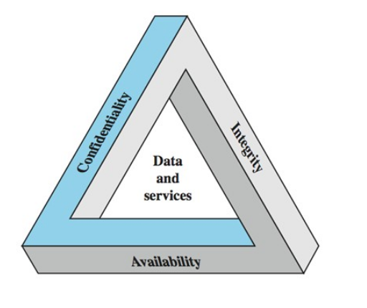
Key Security Concept

Slide 7
Confidentiality
Confidentiality – ensures that sensitive information are accessed only by an authorized person and kept away from those not authorized to possess them. It is implemented using security mechanisms such as usernames, passwords, access control lists (ACLs), and encryption.
Some measures to keep your information confidential are:
Encryption
Password
Two-factor authentication
Bio-metric

Slide 8
Integrity
Integrity – ensures that information are in a format that is true and correct to its original purposes. Integrity, in the world of information security means maintaining the accuracy, and completeness of data. It is about protecting data from being modified or misused by an unauthorized party.
Measures to maintain the integrity of information include:
Encryption
Backups

Slide 9
Availability
Availability means that information is accessible to authorized users. It is basically an assurance that your system and data are accessible by authorized users whenever it’s needed.
Measures to mitigate threats to availability include:
Off-site backups
Disaster recovery
Redundancy
Proper monitoring
Environmental controls
Virtualization

Slide 10

Thank You

